Slide 1
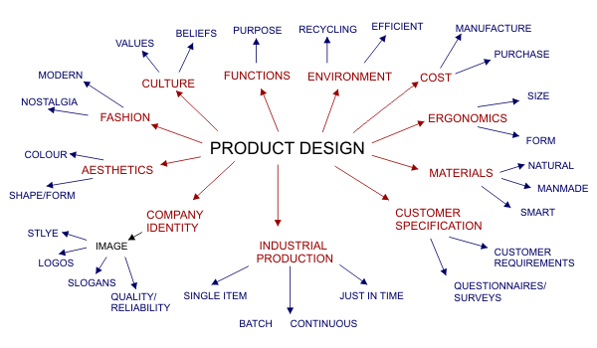
Identifying Factors
Design & Manufacture

Slide 2
Identifying Factors
What are Factors? And how do we identify them?
Product Analysis is the process of identifying, looking at or disassembling a product and identifying its main features. The aim is to understand more about a product and improve it in the future. Many factors influence the development of a product, some are listed below.

Slide 3
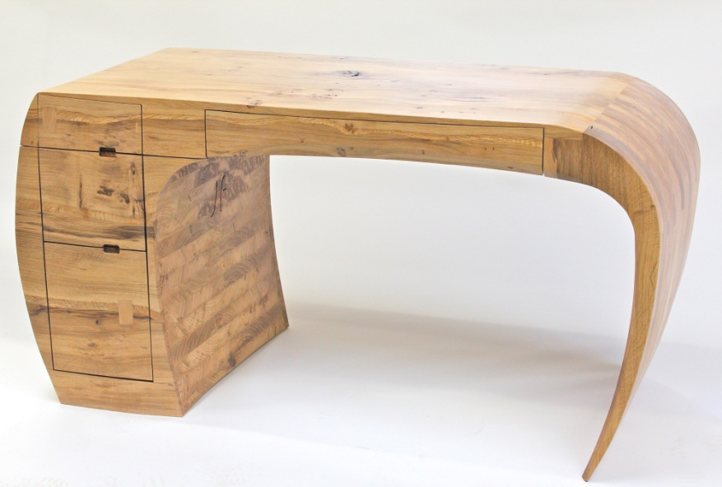
What do all of these Factors mean?
There are many, many design factors that you could think about to analyse a product. In this lesson we will go through the more important ones that were shown in the previous mind map.
Function What does the product do? Does it only do one thing, or does it do many things? Normally products have one main function, this is called the Primary Function. Along with the main function, the product may also have many other functions that are less important, these are called Secondary Functions.
Primary function of this product is having a space to do work of some sorts as it is a desk.
Secondary functions are Storage (it has drawers) and to be nice to look at (it is not your average flat pack desk)

Slide 4
Environment Many people (potential customers) are concerned about the environment and the damage caused to it by industrial production. When designing a product it may be wise to ensure that the materials can be recycled or the product itself can be manufactured from a large proportion of recycled materials.
Along with looking into recycled materials many people like to know if the products were “Greenly” produced and manufactured. So were the products made individually by hand with a small Carbon Footprint, or were they mass produced in a big factory that uses up lots of electricity and have a big Carbon Footprint?

Slide 5
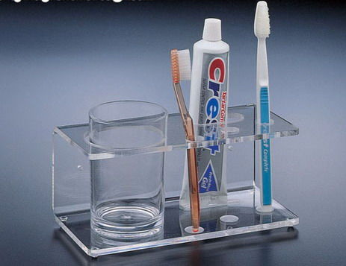
Environment continued...
Location can also come under the Environment heading.
Where will the product be used (inside, outside, what room)? Where will the product be stored when not in use (space/size)?
If you were looking at a product that was going to be used mainly in the bathroom then you would have to think about the environment of a bathroom.... It is a wet and warm environment as this is where people shower and take baths, meaning that condensation will build up on the things in the room. The product would therefore need to be waterproof and easily cleaned. The product would have to be made of a material that would not rot or rust......... etc........

Slide 6
Economics & Performance
Economics is when we are thinking about how much everything is going to cost...What is the cost of the materials and labour required to manufacture the product? How do you know if the price you make the product is going to cover all of your outgoing cost?
Most products are much cheaper to buy today than in the past. This is mainly due to the economies of mass production. The more a process produces, the cheaper each item becomes. The use of modern materials, e.g. plastics, means that complex items can be produced by a single process like injection moulding.
The price of a product depends on creating a balance between:
Manufacturing costs How much it costs to make the product, including materials & labor.
Advertising and distribution costs If potential customers don’t know that you have a new product then no-one will buy it, Advertising the product in magazines/tv/radio costs money. The product also needs to get to the shops from the factory and hiring lorries costs money.
Prices set by other manufacturers If the product is too expensive compaired to similar products that are already on the market customers probably won’t buy it, if it is too cheap then customers might think that it’s no good and not buy it either… the price of the product has to be similar to other similar products but still competitive.

Slide 7
Economics & Performance
Performance when talking about the performance of a product it is important to consider things like Durability, Ease of Maintenance, Running Costs, and more importantly is the product value for money?
To determine whether a product is good value for money you must consider several things:
Is it worth the price it is sold at?
Consider its quality, how well it performs its intended purpose, as well as other design factors such as its aesthetic and ergonomic qualities.
What are the running costs of the product
after the initial purchase cost?
Is the product Durable or will it break easily
after a few uses?
Will it cost anything to maintain? If it breaks
will it be cheaper to fix it or get a new one?
You want to charge me HOW MUCH????!!!!!

Slide 8
Market
Market When thinking about designing a product, a designer must be aware to a certain extent of what marketing entails in order to design a successful product.
Identifying the market To design a product that will appeal to everybody is pretty much impossible. So designers tend to break people up into groups and target them specifically. This is called niche marketing.
Who is the product aimed at?.... Sex Boys/Girls/Both?; Age Old/Young/Both?; Income Poor/Wealthy?; Personality What type of personality do they have? Lifestyle What kind of lifestyle do they have? Sporty/Social etc?; Education Are they well educated?; Location Where do they live? Cities/Countryside? Culture What are their values and beliefs?
Market research At some stage the designer will have to carry out market research (this could be before or after the target market has been defined) in order to gather information about how well the product will sell, what the public want and what the competition is like.
Designers can do this in many ways: Surveys; Focus Groups; Questionnaires; User trails; Tests & Rigs; Comparison to other products; Comparisons to similar products etc...

Slide 9
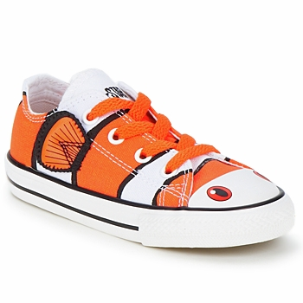
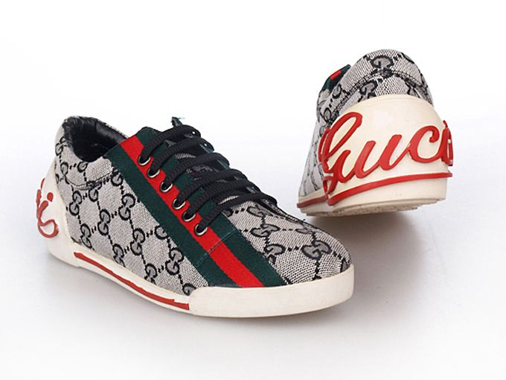
Target Market example...
These trainers are pink and sparkly... They are aimed at Girls.
Demographic = Sex
Look at these shoes... Who do you think that they are aimed at?
These trainers look like a clown fish and are bright in colour... They are aimed at Children.
Demographic = Age
These trainers are a Top Luxury Brand and are very expensive... They are aimed at people with money.
Demographic = Income

Slide 10
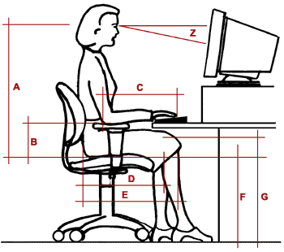
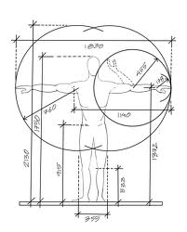
Ergonomics is the study of how humans interact with the products they use. This is when we are thinking how the product will be used and who will be using the product. The product may be designed for human use and therefore ergonomics will play a major role in the design.
Anthropometrics concerns the measurements of the human body. A survey is made of around 1 million people between the ages of about 19 – 65 with every relevant part of the body being measured and recorded.
This information is then compiled to make charts called ‘Anthropometric data tables’ which show us what the smallest, largest and average sizes are. This information is very important when designing for people.
From the tables, designers only use information from the 5th to the 95th percentile. This is because they want to be able to cater for as many people as possible and the people from the 0 – 5 percentile and those from the 96th – 100th percentile are seen as being too extreme, i.e. too small and too big.

Slide 11
Example of Ergonomics and Anthropometrics for an efficient work station

Slide 12
Aesthetics
This is concerned with the ‘appearance’ of a product. This is a very important factor with regards to selling a product because it is literally the first thing the consumer sees. If a product catches your eye and interests you enough to investigate it further it is said to have the ‘X-factor’.
Every product has aesthetic qualities that can be examined in depth. Consideration must be given to the following:
Shape Harmony
Form Balance
Line Light
Colour Pattern
Proportion Texture
Contrast Rhythm
Many of these Aesthetic Factors can affect the way in which customers think and feel about a product and may make them want to but it or not want to buy it...

Slide 13
Your Task
Now that you have been taught about the main factors that designers need to think about when designing new products, your task is to look at the product that you have chosen to Analyse and Evaluate, and Identify as many Factors as you can that you think the designer might have thought about when coming up with their design.
Think about : FUNCTION
ECONOMICS & PERFORMANCE
MARKET
ERGONOMICS
AESTHETICS

